Slide 1
Comment decrire les personnes
Employez des adjectifs pour décrire ces personnes.

Slide 2

Comment est Justin Bieber?
Il est …

Slide 3
Il est bête.

Slide 4

Comment est The Hulk?
Il est …

Slide 5
Il est fort.

Slide 6

Comment est Taylor Swift?
Elle est …

Slide 7
Elle est blonde.

Slide 8

Comment est Nicki Minaj?
Elle est …

Slide 9
Elle est blonde aussi!

Slide 10

Comment est Zach Galifianakis?
Il est …

Slide 11
Il est amusant.

Slide 12

Comment est Angelina Jolie?
Elle est …

Slide 13
Elle est brune.

Slide 14

Comment est Betty White?
Elle est …

Slide 15
Elle est âgée et amusante.

Slide 16
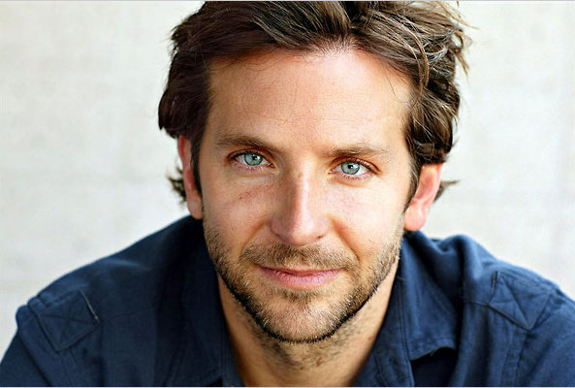
Comment est Bradley Cooper?
Il est …

Slide 17
Il est beau!

Slide 18

Comment est Carrot Top?
Il est …

Slide 19
Il est roux.

Slide 20
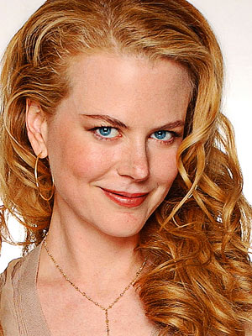
Comment est Nicole Kidman?
Elle est …

Slide 21
Elle est rousse.

Slide 22
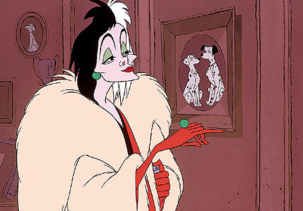
Comment est Cruella deVille?
Elle est …

Slide 23
Elle est méchante.

Slide 24
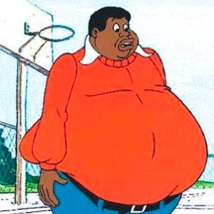
Comment est Fat Albert?
Il est …

Slide 25
Il est gros.

Slide 26

Comment est Jennifer Hudson?
Elle est …

Slide 27
Elle est mince!

Slide 28

Comment est Katniss Everdeen?
Elle est …

Slide 29
Elle est indépendante.

Slide 30

Comment est le président Obama? Il est …

Slide 31
Il est intelligent.

Slide 32

Comment est Oprah?
Elle est …

Slide 33
Elle est généreuse.

Slide 34

Comment est Oscar the Grouch? Il est …

Slide 35
Il est embêtant.

Slide 36
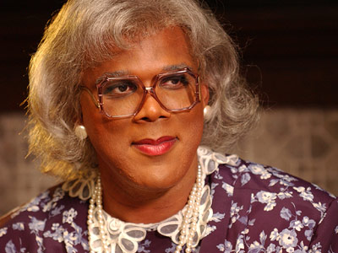
Comment est Tyler Perry?
Il est …

Slide 37
Il est amusant.

Slide 38
Webliography
http://www.google.com/imgres?q=justin+bieber&hl=en&safe=active&biw=1280&bih=572&tbm=isch&tbnid=xtGYUAMULsxyWM:&imgrefurl=http://www.showbiz411.com/2012/06/25/justin-bieber-believe-cd-numbers-lower-than-expected-amazon-selling-it-for-4-99&docid=1g-K5BBCsLP9GM&imgurl=http://www.showbiz411.com/wp-content/uploads/2012/06/justin-bieber-m.jpg&w=475&h=330&ei=MNdXUL_qNqfz0gHZ4YDIBw&zoom=1
http://www.google.com/imgres?q=the+hulk&hl=en&safe=active&biw=1280&bih=572&tbm=isch&tbnid=W6vsdQ2W02poIM:&imgrefurl=http://deltorofilms.com/wp/tag/the-hulk&docid=Krc8fIotbj3z2M&imgurl=http://deltorofilms.com/wp/wp-content/uploads/2010/11/the-hulk-od-2003.jpg&w=652&h=577&ei=vdZXUKIks4PRAeTdgegF&zoom=1&iact=hc&vpx=198&vpy=131&dur=31&hovh=211&hovw=239&tx=158&ty=133&sig=104867554678127436510&page=1&tbnh=119&tbnw=134&start=0&ndsp=22&ved=1t:429,r:1,s:0,i:75
http://www.google.com/imgres?q=taylor+swift&hl=en&safe=active&biw=1280&bih=572&tbm=isch&tbnid=6E2jGJ5QQaaVoM:&imgrefurl=http://lyrics.wikia.com/Taylor_Swift&docid=--xLhIS4PrkLaM&imgurl=http://images2.wikia.nocookie.net/__cb20120819031324/lyricwiki/images/c/c0/Taylor_Swift.jpg&w=307&h=307&ei=W9dXUKqdH8e10QGs_oHwCg&zoom=1&iact=hc&vpx=83&vpy=245&dur=78&hovh=225&hovw=225&tx=123&ty=102&sig=104867554678127436510&page=1&tbnh=114&tbnw=114&start=0&ndsp=24&ved=1t:429,r:8,s:0,i:97
http://www.google.com/imgres?q=zach+galifianakis&hl=en&safe=active&biw=1280&bih=572&tbm=isch&tbnid=iI-IH5lw26pDSM:&imgrefurl=http://ravepad.com/page/zach-galifianakis/images/view/76125/Zach-Galifianakis&docid=5AP46StUU6BlHM&imgurl=http://3.bp.blogspot.com/_uyOOopsVPoI/SzJvuvtIMtI/AAAAAAAAB7c/-r2iMjcL8MM/s640/Zach_Galifianakis---40.jpg&w=374&h=560&ei=oddXUP74MqLn0QGmgIHAAg&zoom=1&iact=hc&vpx=925&vpy=179&dur=1045&hovh=275&hovw=183&tx=91&ty=193&sig=104867554678127436510&page=1&tbnh=116&tbnw=84&start=0&ndsp=28&ved=1t:429,r:26,s:0,i:152
http://www.google.com/imgres?q=nicki+minaj&hl=en&safe=active&biw=1280&bih=572&tbm=isch&tbnid=q7BnkAy11K0VOM:&imgrefurl=http://thebestmusicnow.wordpress.com/tag/nicki-minaj/&docid=RRJMrDpaPrMMVM&imgurl=http://thebestmusicnow.files.wordpress.com/2012/04/nicki-minaj-youraudiofix-copy.jpg&w=490&h=300&ei=SNhXUJ_vIuq10AGVmYH4Cg&zoom=1&iact=hc&vpx=491&vpy=273&dur=437&hovh=176&hovw=287&tx=140&ty=112&sig=104867554678127436510&page=1&tbnh=108&tbnw=144&start=0&ndsp=23&ved=1t:429,r:11,s:0,i:106
http://www.google.com/imgres?q=angelina+jolie&hl=en&safe=active&biw=1280&bih=572&tbm=isch&tbnid=QsPrVriCLqM-tM:&imgrefurl=http://sweetfuzz.com/2009/02/16/angelina-jolie-style-guide/&docid=sZtwytmsb2N2nM&imgurl=http://images.fanpop.com/images/image_uploads/Angelina-Jolie-angelina-jolie-686716_333_500.jpg&w=333&h=500&ei=0CBZUPbEOpOO9ASBsoG4Aw&zoom=1&iact=hc&vpx=711&vpy=179&dur=343&hovh=275&hovw=183&tx=92&ty=119&sig=104867554678127436510&page=3&tbnh=127&tbnw=100&start=53&ndsp=28&ved=1t:429,r:11,s:53,i:275

Slide 39
http://www.google.com/imgres?q=betty+white&hl=en&safe=active&biw=1280&bih=572&tbm=isch&tbnid=po_IUmU7kpWYcM:&imgrefurl=http://punchingkitty.com/2010/11/29/betty-white-stole-some-jewelry-in-ofallon-missouri/&docid=FkxWKfIx0BxjSM&imgurl=http://media.punchingkitty.com/wordpress/2010/11/Betty-White.jpeg&w=322&h=400&ei=8yJZUK3ZOI_o8QS3l4DQBQ&zoom=1&iact=hc&vpx=728&vpy=203&dur=281&hovh=250&hovw=201&tx=112&ty=201&sig=104867554678127436510&page=1&tbnh=114&tbnw=106&start=0&ndsp=27&ved=1t:429,r:24,s:0,i:146
http://www.google.com/imgres?q=bradley+cooper&hl=en&safe=active&biw=1280&bih=572&tbm=isch&tbnid=lDmiBlVQDjFsXM:&imgrefurl=http://heavenrider.com/bradley-cooper-workout-routine-and-diet/&docid=dD4gNt1JJD6sfM&imgurl=http://heavenrider.com/wp-content/uploads/2012/06/bradley-cooper.jpg&w=593&h=400&ei=gSNZUMyrHIfG9gT4s4DQDQ&zoom=1&iact=hc&vpx=458&vpy=144&dur=5475&hovh=184&hovw=273&tx=174&ty=142&sig=104867554678127436510&page=1&tbnh=117&tbnw=152&start=0&ndsp=29&ved=1t:429,r:4,s:0,i:84
http://www.google.com/imgres?q=carrot+top&num=10&hl=en&safe=active&biw=1280&bih=572&tbm=isch&tbnid=mWzYZPzU74hTVM:&imgrefurl=http://people.zap2it.com/p/carrot-top/74121&docid=vQHUafSdxDVYwM&imgurl=http://images.zap2it.com/images/celeb-74121/carrot-top-1.jpg&w=540&h=720&ei=rBxZUJ_hGIGS9gSU-YCICQ&zoom=1&iact=hc&vpx=632&vpy=104&dur=13353&hovh=259&hovw=194&tx=75&ty=197&sig=104867554678127436510&page=1&tbnh=112&tbnw=94&start=0&ndsp=29&ved=1t:429,r:5,s:0,i:90
http://www.google.com/imgres?q=cruella+deville&hl=en&safe=active&biw=1280&bih=572&tbm=isch&tbnid=4KaI3NiJvf0MDM:&imgrefurl=http://thegloss.com/fashion/fashion-lessons-from-childhood-fiction-101-dalmatians/&docid=xYfBGNslq4Z1PM&imgurl=http://thegloss.com/files/2010/05/cruella-de-vil1.jpg&w=431&h=300&ei=ESJZULDxMo2o8gSz9oHgDg&zoom=1&iact=hc&vpx=454&vpy=267&dur=4555&hovh=187&hovw=269&tx=164&ty=127&sig=104867554678127436510&page=1&tbnh=131&tbnw=165&start=0&ndsp=15&ved=1t:429,r:10,s:0,i:109
http://www.google.com/imgres?q=fat+albert&hl=en&safe=active&biw=1280&bih=572&tbm=isch&tbnid=7CeOBKZ3HsvbnM:&imgrefurl=http://www.pastemagazine.com/blogs/lists/2010/05/the-50-best-cartoon-characters-of-all-time.html%3Fp%3D6&docid=L29WoZ85iLpvTM&imgurl=http://cdn.pastemagazine.com/www/blogs/lists/2010/05/12/fat_albert.jpg&w=300&h=300&ei=JCdZULOzLIa09gSAoYDADg&zoom=1&iact=hc&vpx=911&vpy=228&dur=312&hovh=225&hovw=225&tx=121&ty=224&sig=104867554678127436510&page=1&tbnh=114&tbnw=111&start=0&ndsp=23&ved=1t:429,r:21,s:0,i:137
http://www.google.com/imgres?q=jennifer+hudson+weight+loss&hl=en&safe=active&biw=1280&bih=572&tbm=isch&tbnid=s0gSFaZDchZ0CM:&imgrefurl=http://blisstree.com/live/jennifer-hudsons-weight-loss-attitude-right-or-wrong/&docid=_broJzIkKR8PpM&imgurl=http://cdn.blisstree.com/files/2011/08/jennifer-hudson-weight-loss.jpg&w=518&h=725&ei=jiVZUPrjA4b49QSTtIFg&zoom=1&iact=hc&vpx=261&vpy=187&dur=1357&hovh=266&hovw=190&tx=126&ty=212&sig=104867554678127436510&page=1&tbnh=127&tbnw=88&start=0&ndsp=16&ved=1t:429,r:9,s:0,i:106

Slide 40
http://www.google.com/imgres?q=Tyler+perry&hl=en&safe=active&biw=1280&bih=572&tbm=isch&tbnid=t-k_qZubSmJYuM:&imgrefurl=http://www.bornrich.com/tyler-perry.html&docid=Op1U5N9nvRYNCM&imgurl=http://www.instablogsimages.com/1/2011/12/03/1322890897114.jpg&w=400&h=300&ei=QR1ZUMuJK4G-9QSP8oCIBQ&zoom=1&iact=rc&dur=93&sig=104867554678127436510&page=1&tbnh=114&tbnw=158&start=0&ndsp=27&ved=1t:429,r:9,s:0,i:100&tx=132&ty=47
http://www.google.com/imgres?q=jennifer+lawrence&hl=en&safe=active&biw=1280&bih=572&tbm=isch&tbnid=7pvleeTWXq2wmM:&imgrefurl=http://www.guardian.co.uk/film/2012/aug/07/jennifer-lawrence-pay-hunger-games-sequel&docid=giYWP3QBbt-PxM&imgurl=http://static.guim.co.uk/sys-images/Guardian/Archive/Search/2012/8/7/1344335749892/Jennifer-Lawrence-in-The--008.jpg&w=460&h=276&ei=ph1ZUID7DIHK9gSwg4HQDg&zoom=1&iact=hc&vpx=818&vpy=88&dur=109&hovh=174&hovw=290&tx=174&ty=126&sig=104867554678127436510&page=1&tbnh=116&tbnw=156&start=0&ndsp=24&ved=1t:429,r:22,s:0,i:140
http://www.google.com/imgres?q=oprah&hl=en&safe=active&biw=1280&bih=572&tbm=isch&tbnid=2EEk2ommOjVOCM:&imgrefurl=http://politic365.com/2012/09/06/oprah-winfrey/&docid=q2HxPVMmjPuEgM&imgurl=http://politic365.com/wp-content/blogs.dir/1/files/2012/09/Oprah_Winfrey.jpg&w=374&h=250&ei=4B9ZUOWvBJT69gSf6YHQAw&zoom=1&iact=hc&vpx=596&vpy=147&dur=1888&hovh=183&hovw=275&tx=137&ty=123&sig=104867554678127436510&page=1&tbnh=123&tbnw=157&start=0&ndsp=24&ved=1t:429,r:5,s:0,i:87
http://www.google.com/imgres?q=nicole+kidman+red+hair&hl=en&safe=active&biw=1280&bih=572&tbm=isch&tbnid=_CpoS6QKCag4wM:&imgrefurl=http://wrongfulconvictionsblog.org/category/filmcinema/page/2/&docid=JkMew9OCT0SlRM&imgurl=http://globalwrong.files.wordpress.com/2012/04/nicole_kidman1_300_400.jpg&w=300&h=400&ei=fCBZUKm4BpL68QTnqYD4Cw&zoom=1&iact=hc&vpx=188&vpy=107&dur=2793&hovh=259&hovw=194&tx=87&ty=143&sig=104867554678127436510&page=1&tbnh=118&tbnw=88&start=0&ndsp=29&ved=1t:429,r:1,s:0,i:75
http://www.google.com/imgres?q=obama&hl=en&safe=active&biw=1280&bih=572&tbm=isch&tbnid=3KZDa-VTROs_dM:&imgrefurl=http://www.boston.com/bigpicture/2008/11/the_next_president_of_the_unit.html&docid=f-ZO76iNIFC41M&imgurl=http://cache.boston.com/universal/site_graphics/blogs/bigpicture/obama_11_05/obama01_16773717.jpg&w=990&h=678&ei=TyFZUNO5A4jC9gSkrIDACw&zoom=1&iact=hc&vpx=191&vpy=267&dur=5616&hovh=186&hovw=271&tx=110&ty=89&sig=104867554678127436510&page=1&tbnh=116&tbnw=167&start=0&ndsp=25&ved=1t:429,r:10,s:0,i:103
http://www.google.com/imgres?q=oscar+the+grouch&hl=en&safe=active&biw=1280&bih=572&tbm=isch&tbnid=x8rEiFRrMX5nVM:&imgrefurl=http://oscar-the-grouch.deviantart.com/&docid=8EUNQhHxGpf3YM&imgurl=http://www.cynicalnation.com/img/oscar.jpg&w=250&h=323&ei=tyJZUM_hA4Wm8gTxjICYBA&zoom=1

